Slide 1
Process and Task Engines
Module - 19

Slide 2
Contents
Architectural Overview
Features
Business analysis
Creating a Process
Task Extension

Slide 3
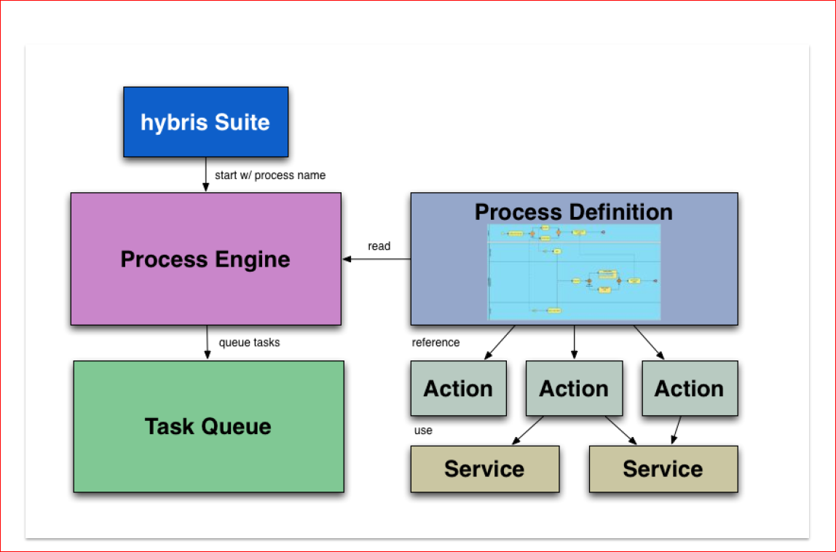
Architecture of the Process and Task Engines

Slide 4
Contents
Architectural Overview
Features
Business analysis
Creating a Process
Task Extension

Slide 5
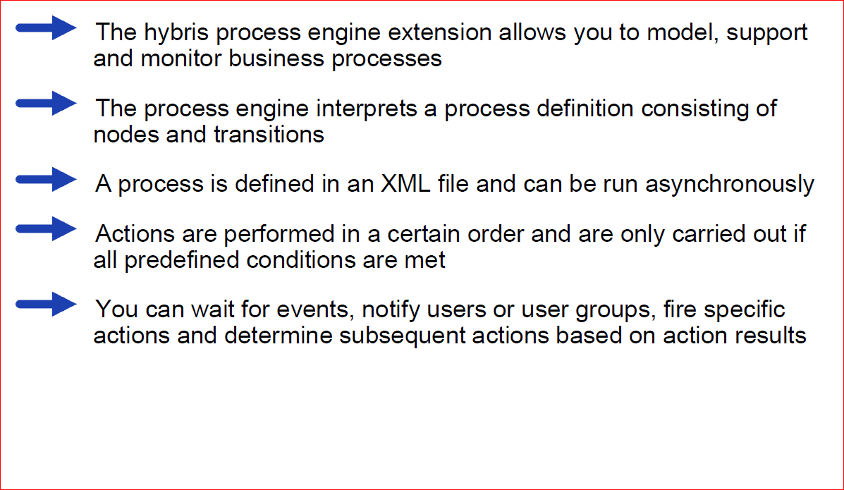
Process Engine Features

Slide 6
Contents
Architectural Overview
Features
Business analysis
Creating a Process
Task Extension

Slide 7
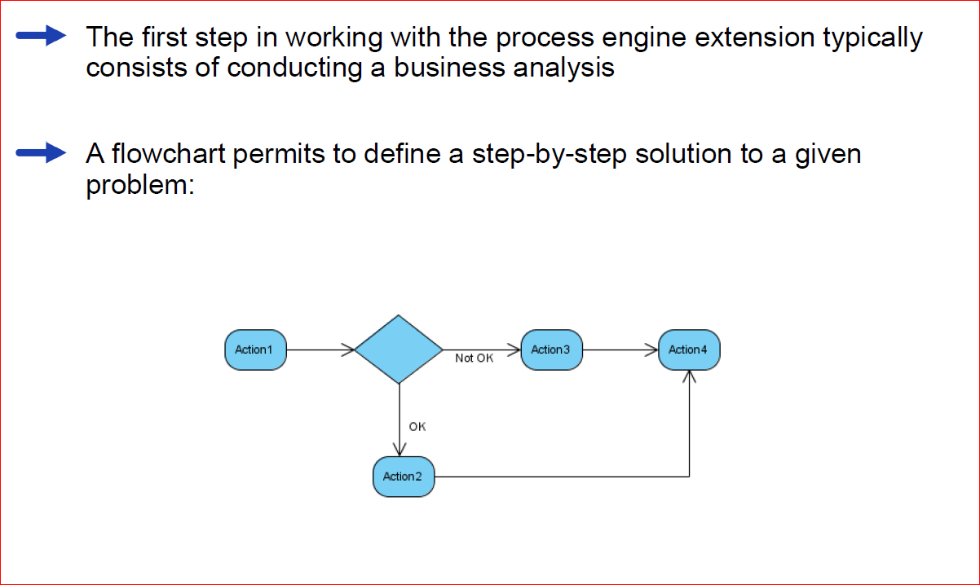
Business analysis

Slide 8
Contents
Architectural Overview
Features
Business analysis
Creating a Process
Task Extension

Slide 9
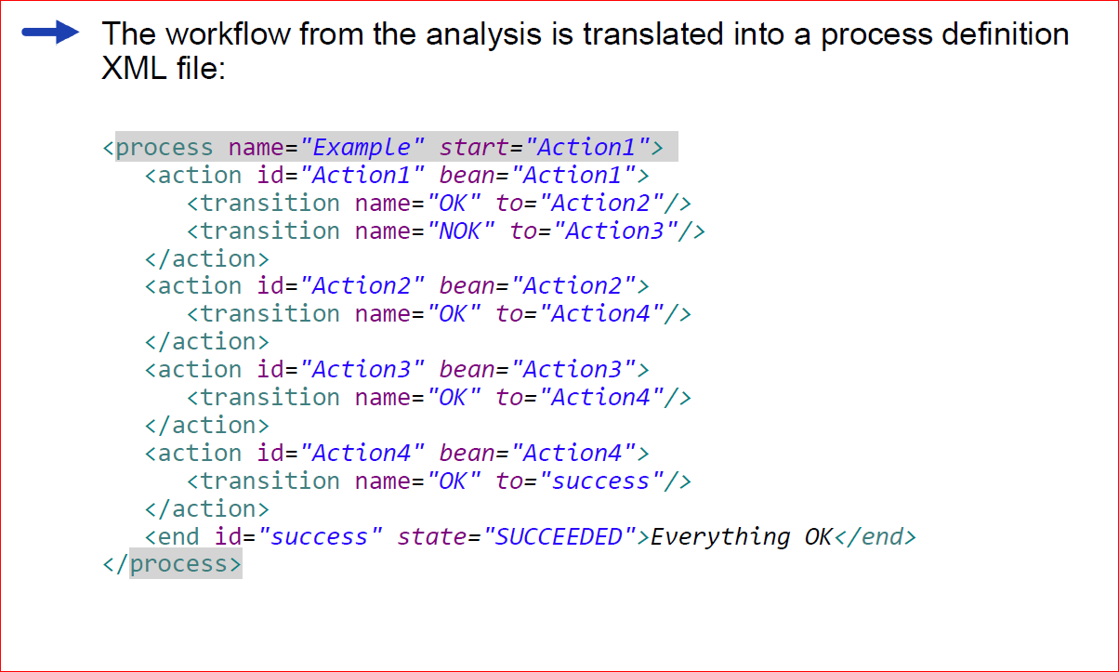
Process definition file

Slide 10
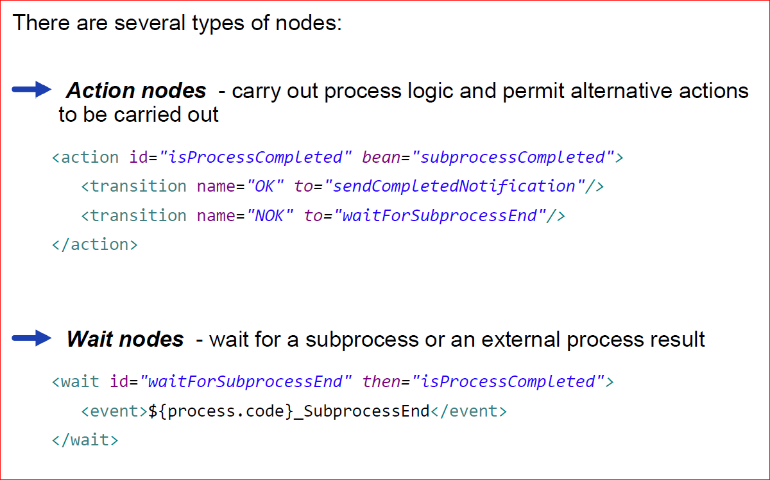
Node Types (1)

Slide 11
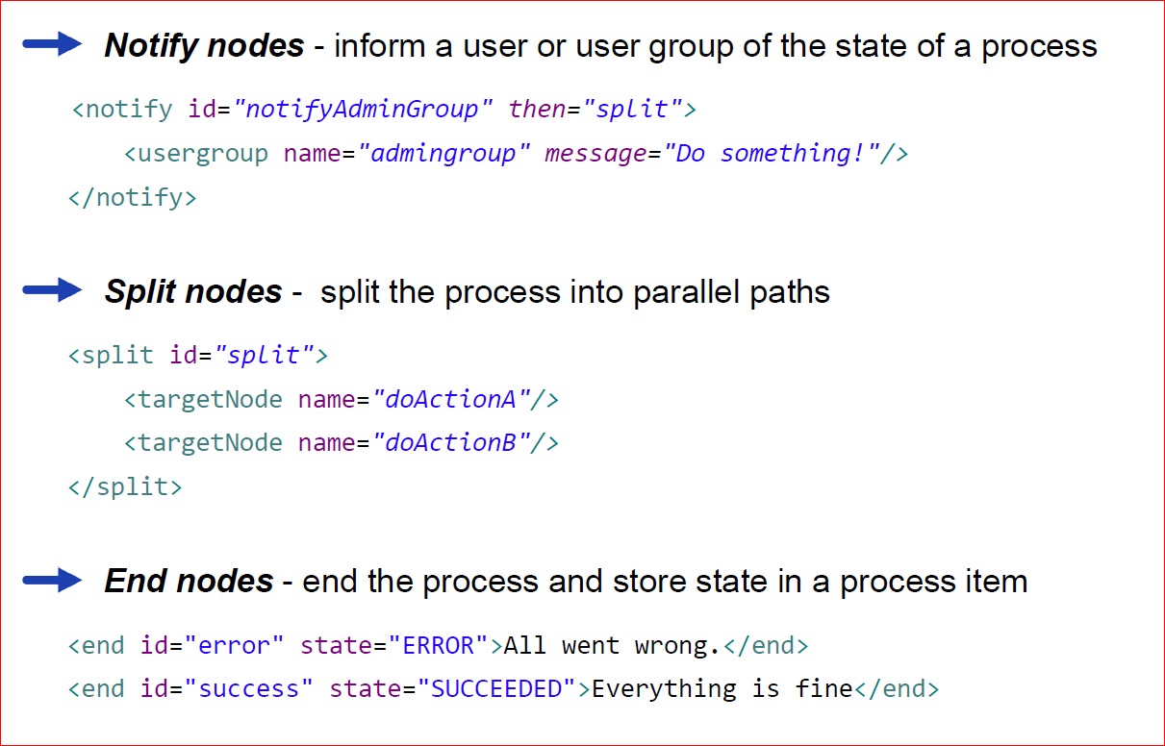
Node Types (2)

Slide 12
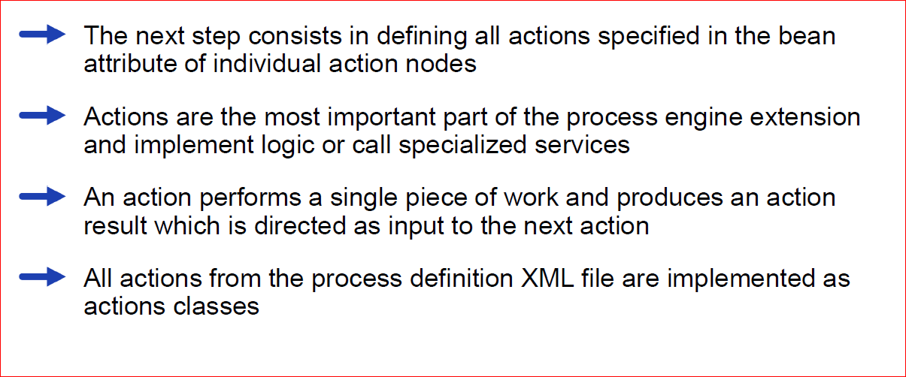
Process Actions

Slide 13
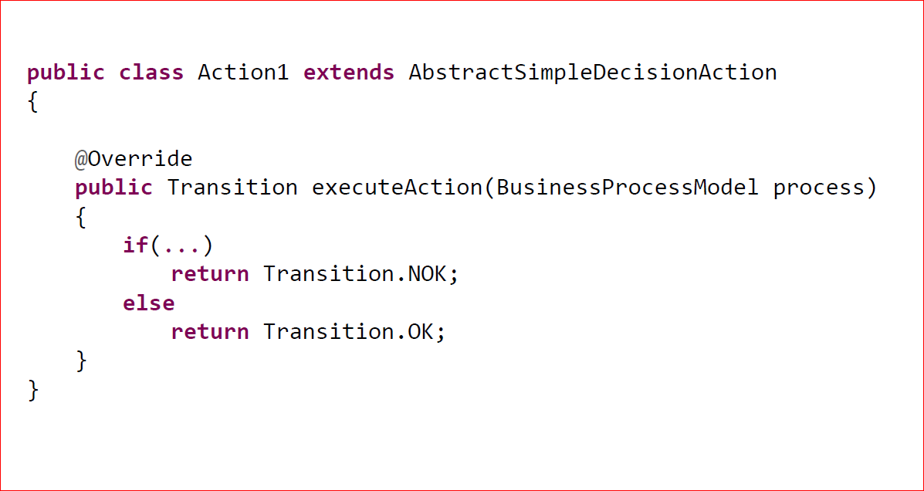
AbstractSimpleDecisionAction

Slide 14
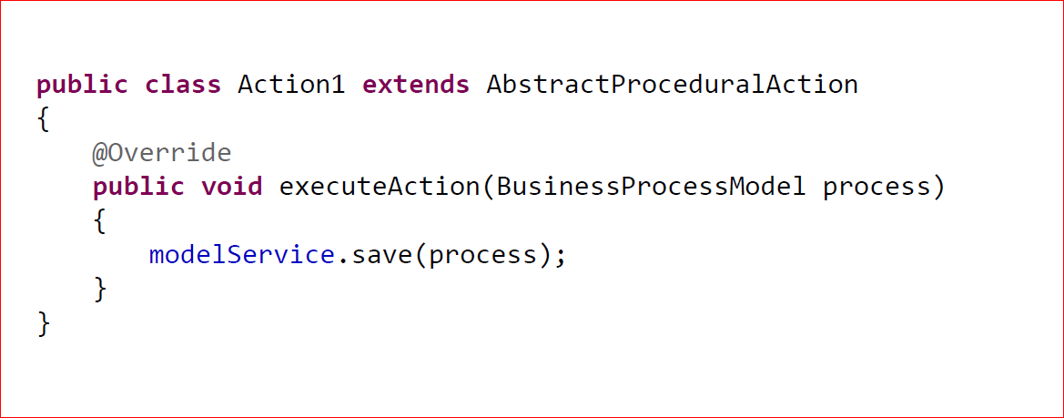
AbstractProceduralAction

Slide 15
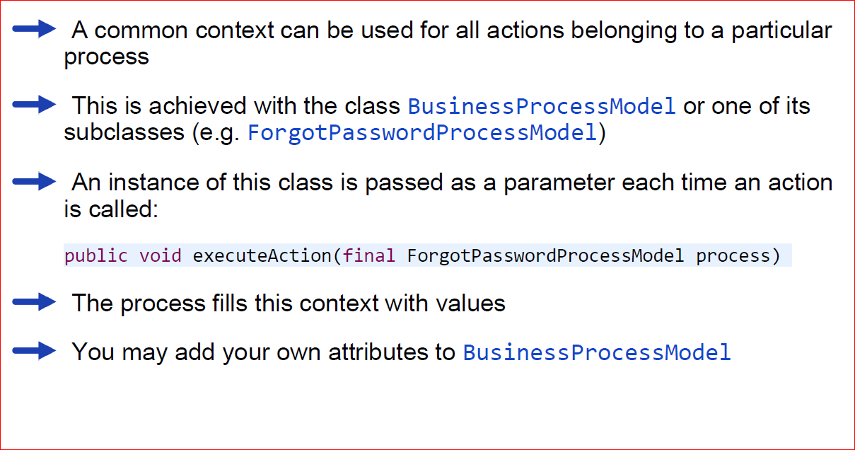
Using a common context

Slide 16
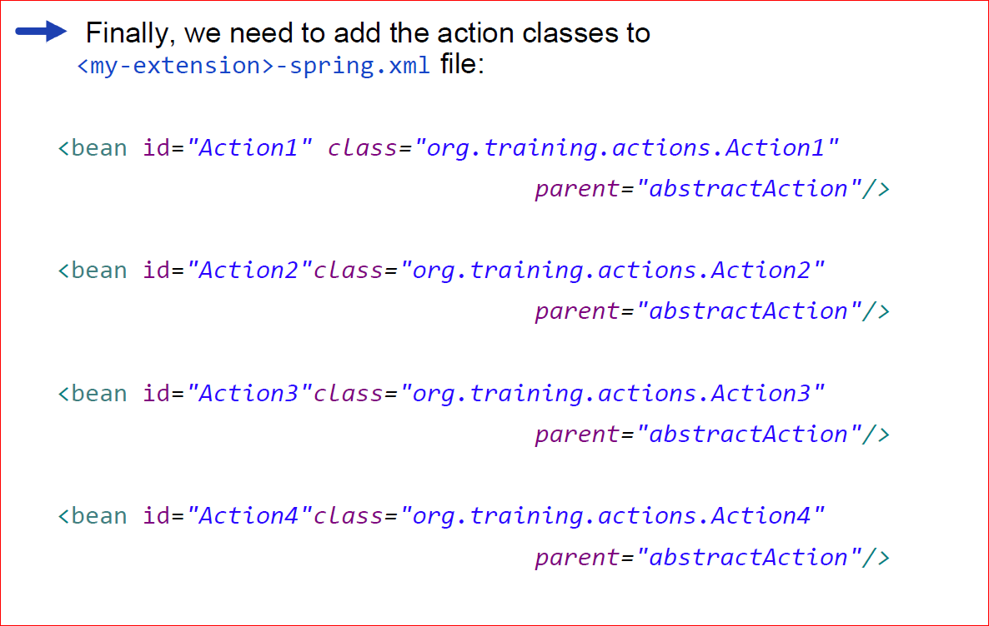
Integration with Spring

Slide 17
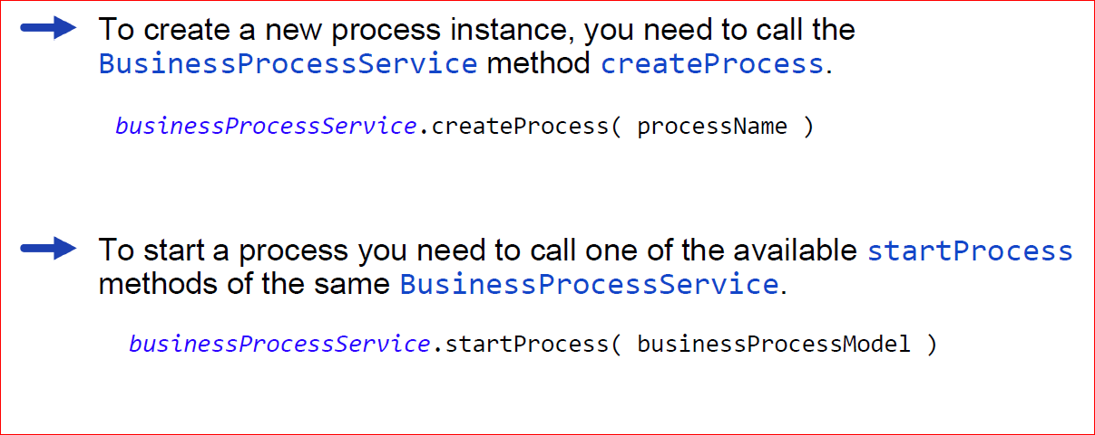
Creating and Starting a Process

Slide 18
Contents
Architectural Overview
Features
Business analysis
Creating a Process
Task Extension

Slide 19
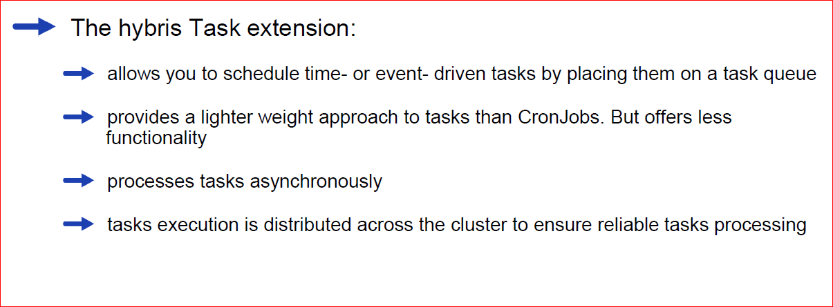
Foundation used for single-process engine step

Slide 20
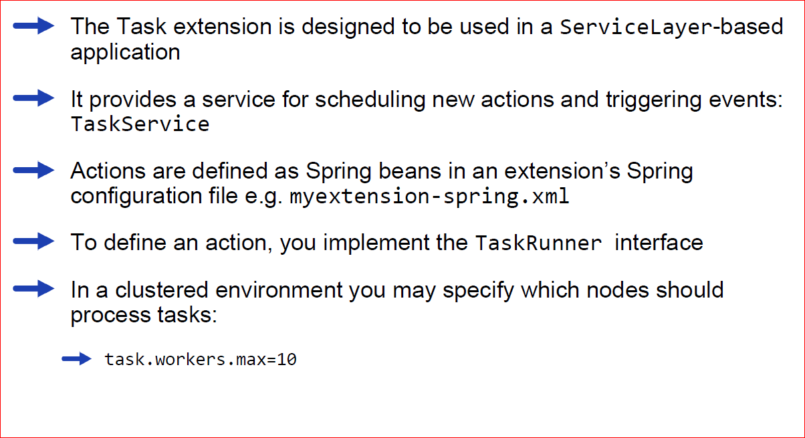
The Task Engine

Slide 21
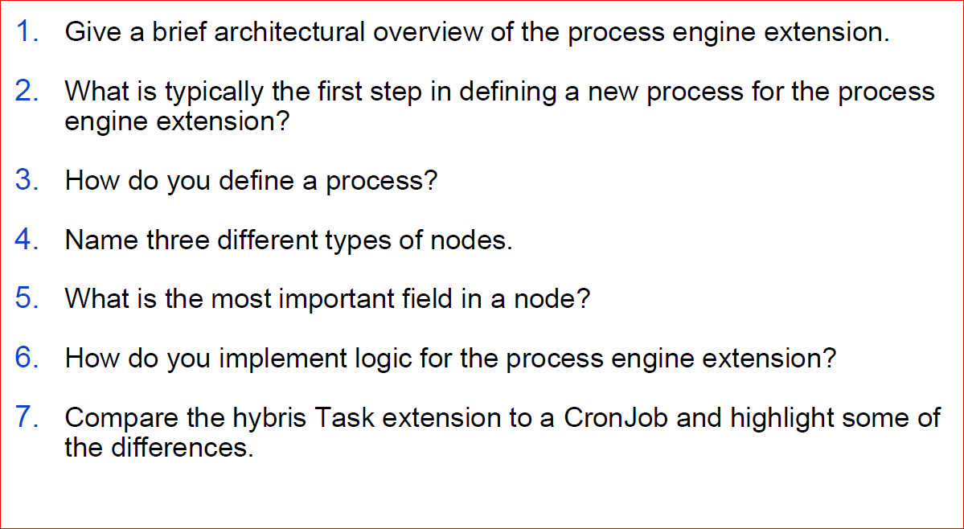
Quizees

Slide 22
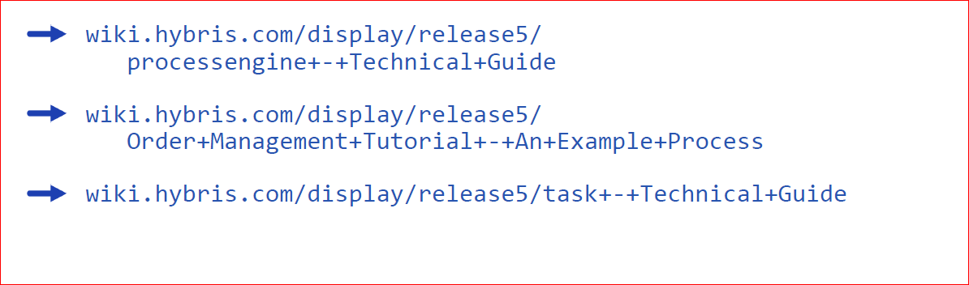
References

